Slide 1

Gift Game
Team N/A

Slide 2

Team N/A
Gabe Landwehr – Lead Designer
Tre Stoterau – Project Manager
Austin Krieger – Admin
Evan Winters – QA & Utility
Phyzon Milton – Marketing & Art
Jordan Kudray – Utility
Drew Concha – Sound FX & Programming
Jayme Skaggs – Art

Slide 3


Slide 4

The Concept
The Pitch: Shake, swap, and steal your way to the best haul in this exciting new mobile game about opening the best presents. Rattle the package to hear what’s inside, inspect the outside, and make your best judgement as to what’s inside, but beware, it’s not always what you think.
Core Experience: Excitement of participating in a wacky present swap where anything is possible.

Slide 5

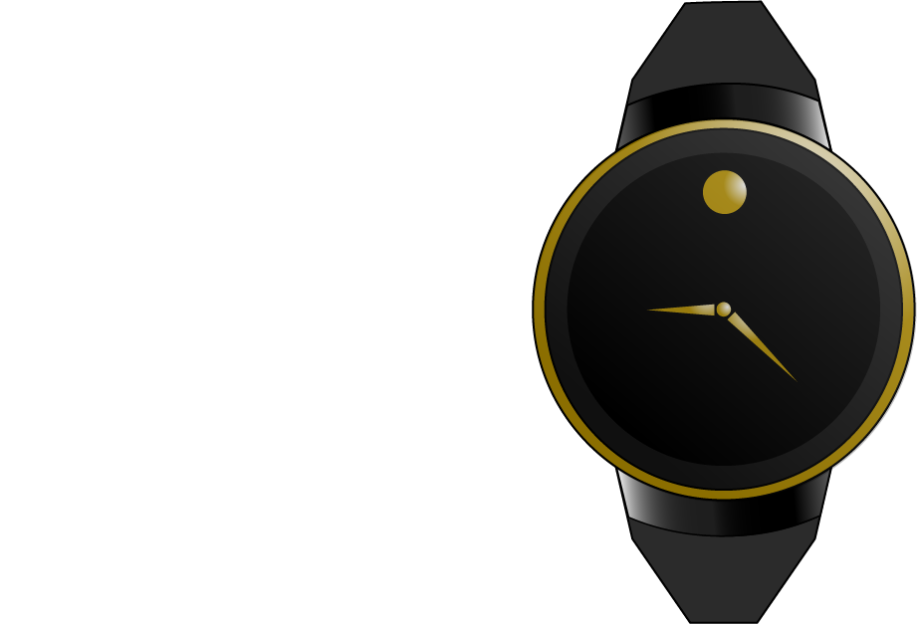
Gameplay
Party-style game for 3-8 players
A single device is passed around the group.
Shake the phone to hear a sound.
Ex: Ticking = watch or bomb
“Wet slap” = dead fish, or waterbed

Slide 6
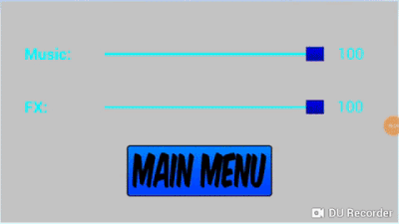
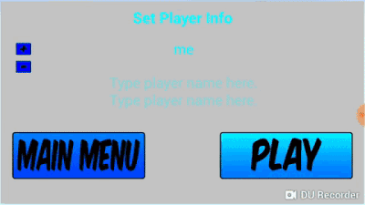
Gameplay

Slide 7
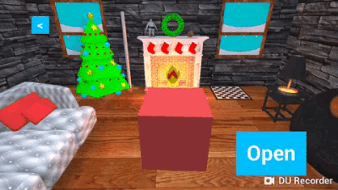
Gameplay

Slide 8

Issues
I was not prepared to be a leader - Gabe
Personal Motivation to learn certain aspects- Tre
Time management - Austin
Not having goals - Evan
Balancing marketing and art - Phyzon
Unfamiliar with art tools - Jordan
Never having learned game engine - Drew
[INSERT ISSUE HERE] - Jayme

Slide 9

Solutions
Listening to my team - Gabe
Fully utilizing paired development - Tre
Prioritizing tasks - Austin
Asking for specific tasks - Evan
Taking things one step at a time - Phyzon
Practicing tools & online resources - Jordan
Asking for help & researching - Drew
[INSERT SOLUTION HERE] - Jayme

Slide 10
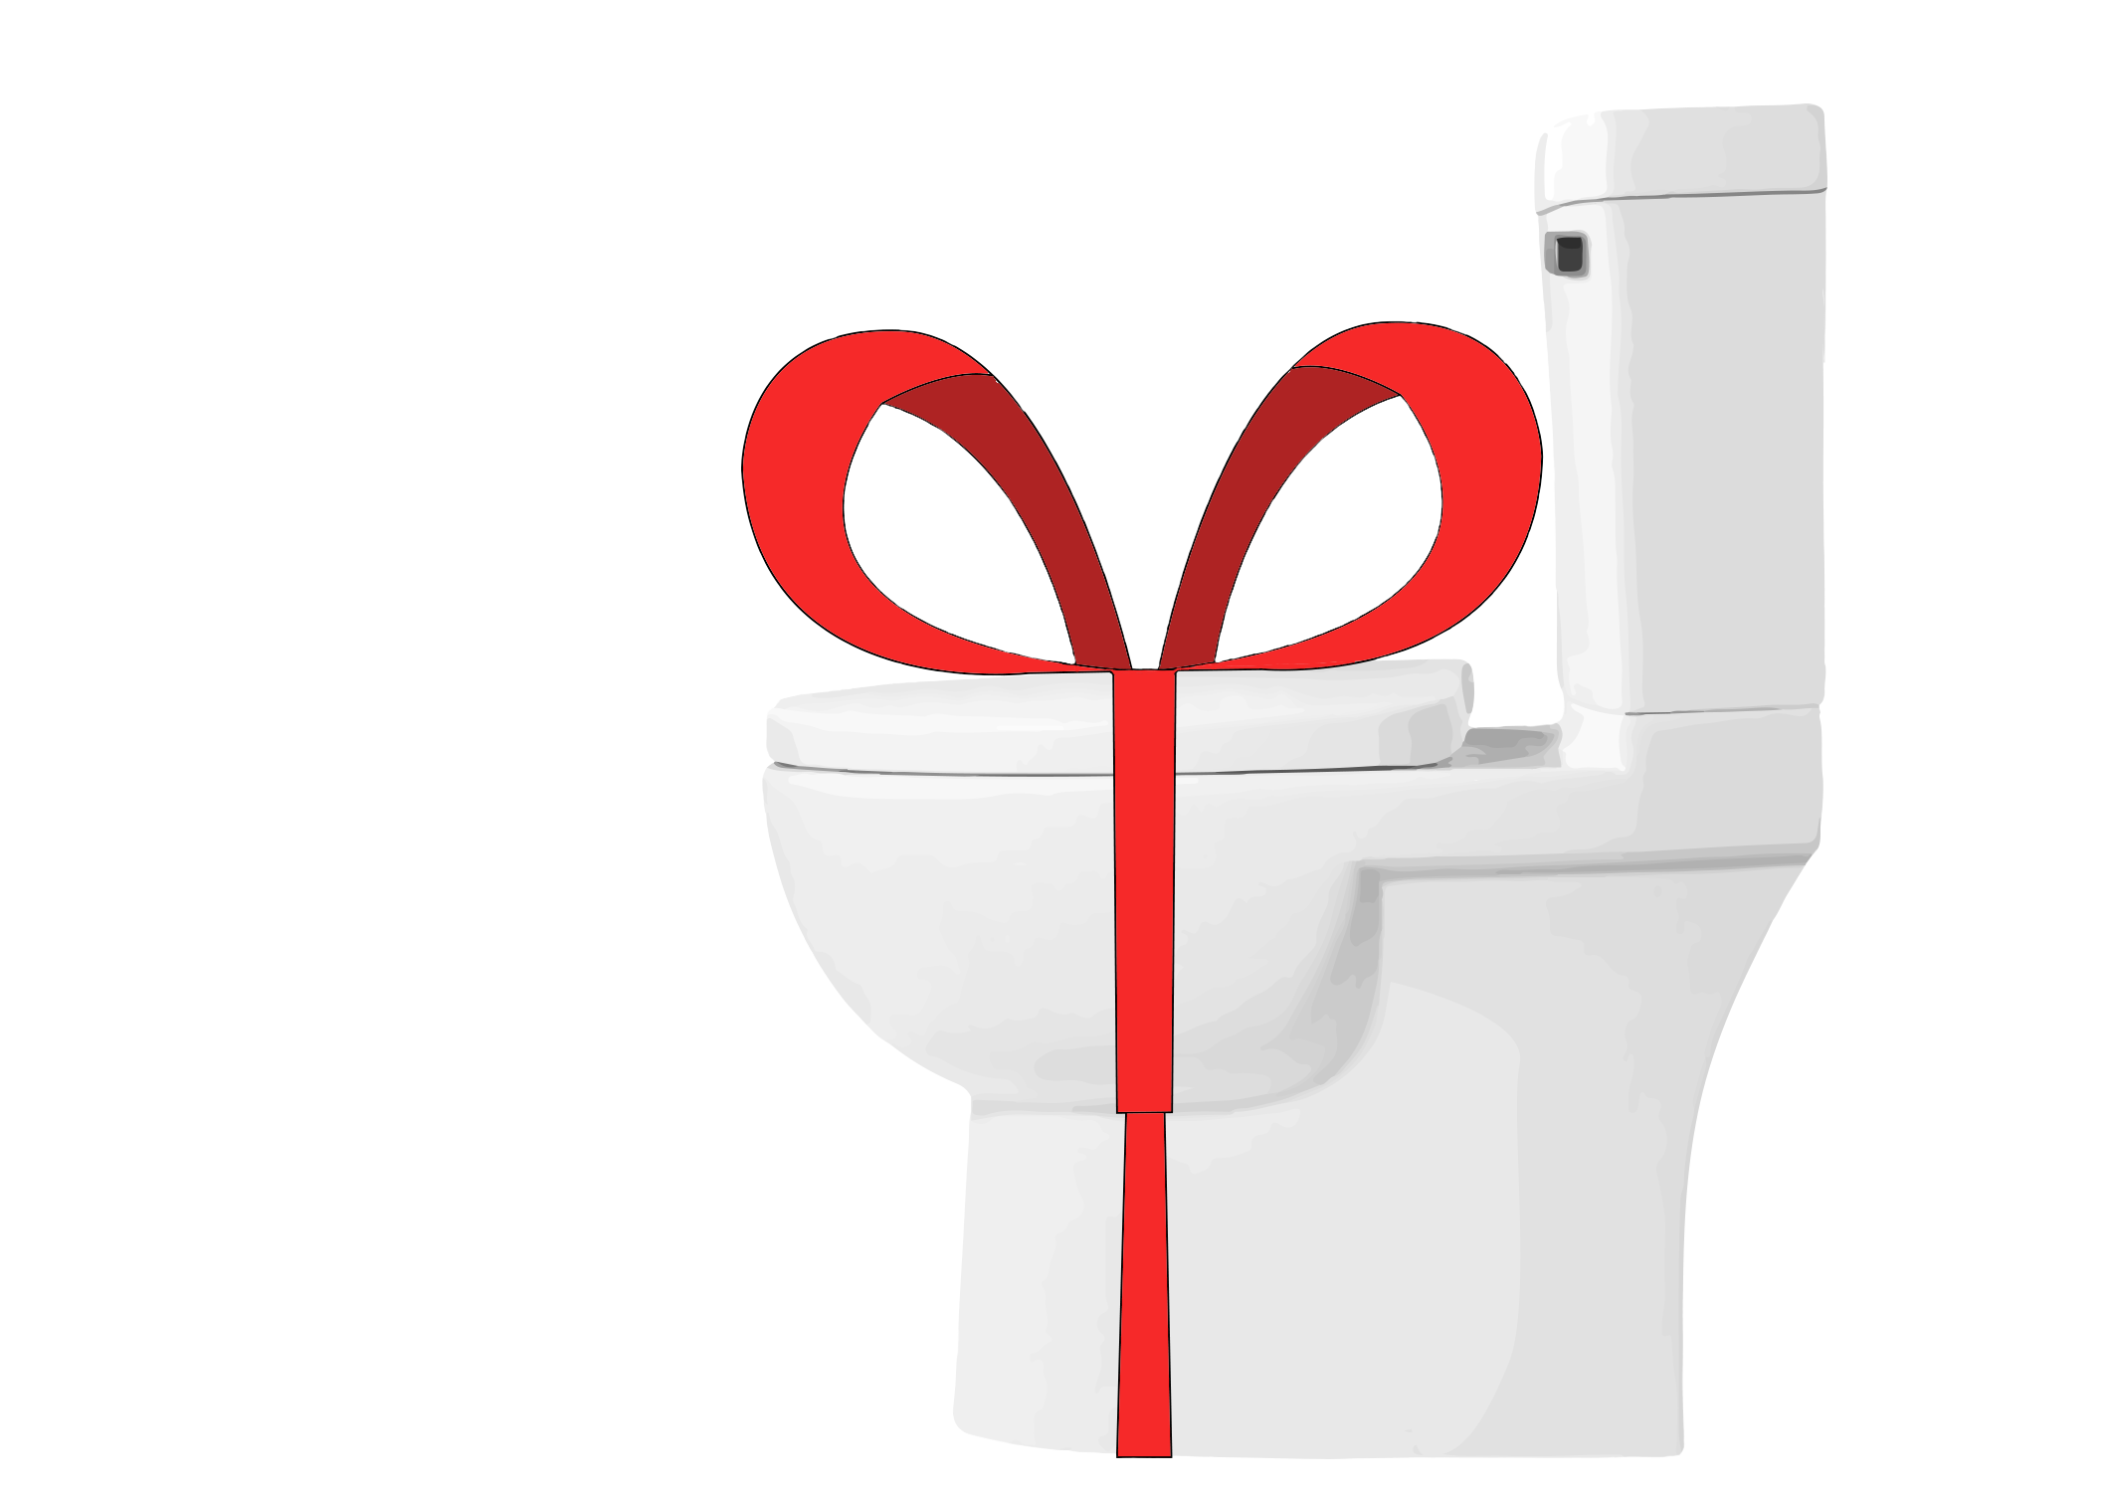
What We Wish We Knew
Networking
Scope creep
Focus on work
Notes:
The game can be done just as well without networking.

Slide 11
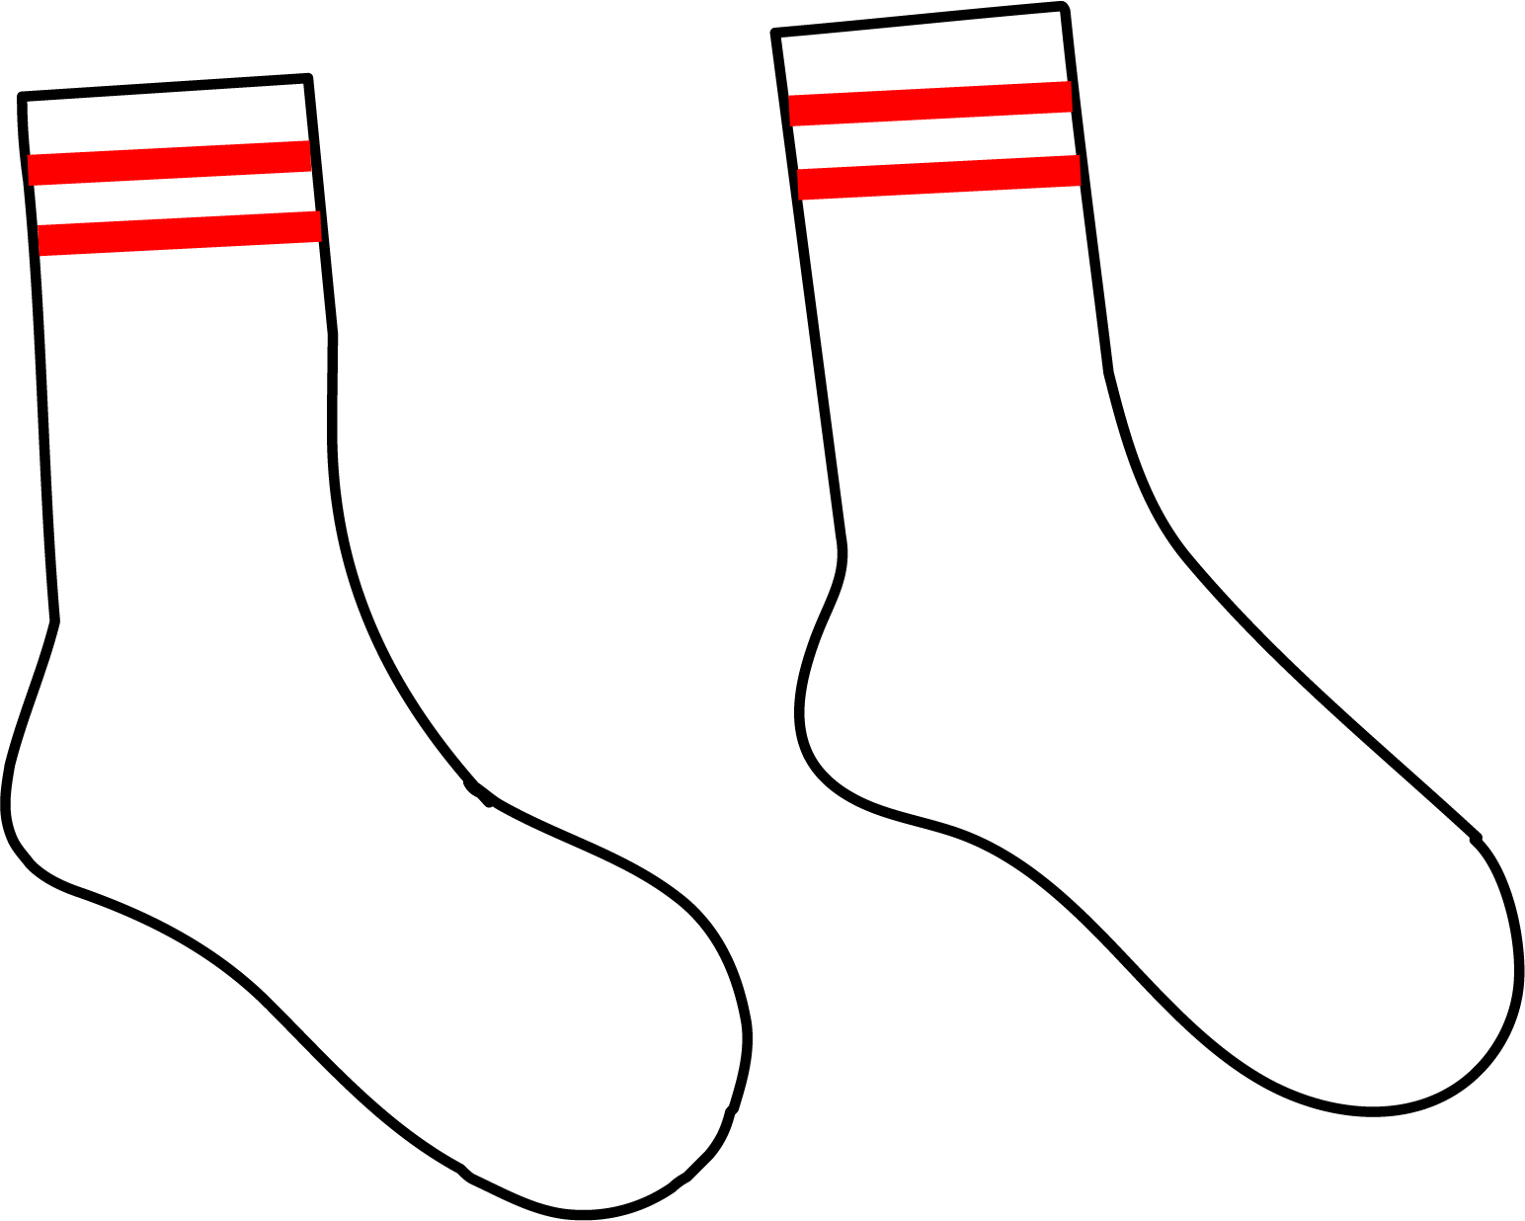
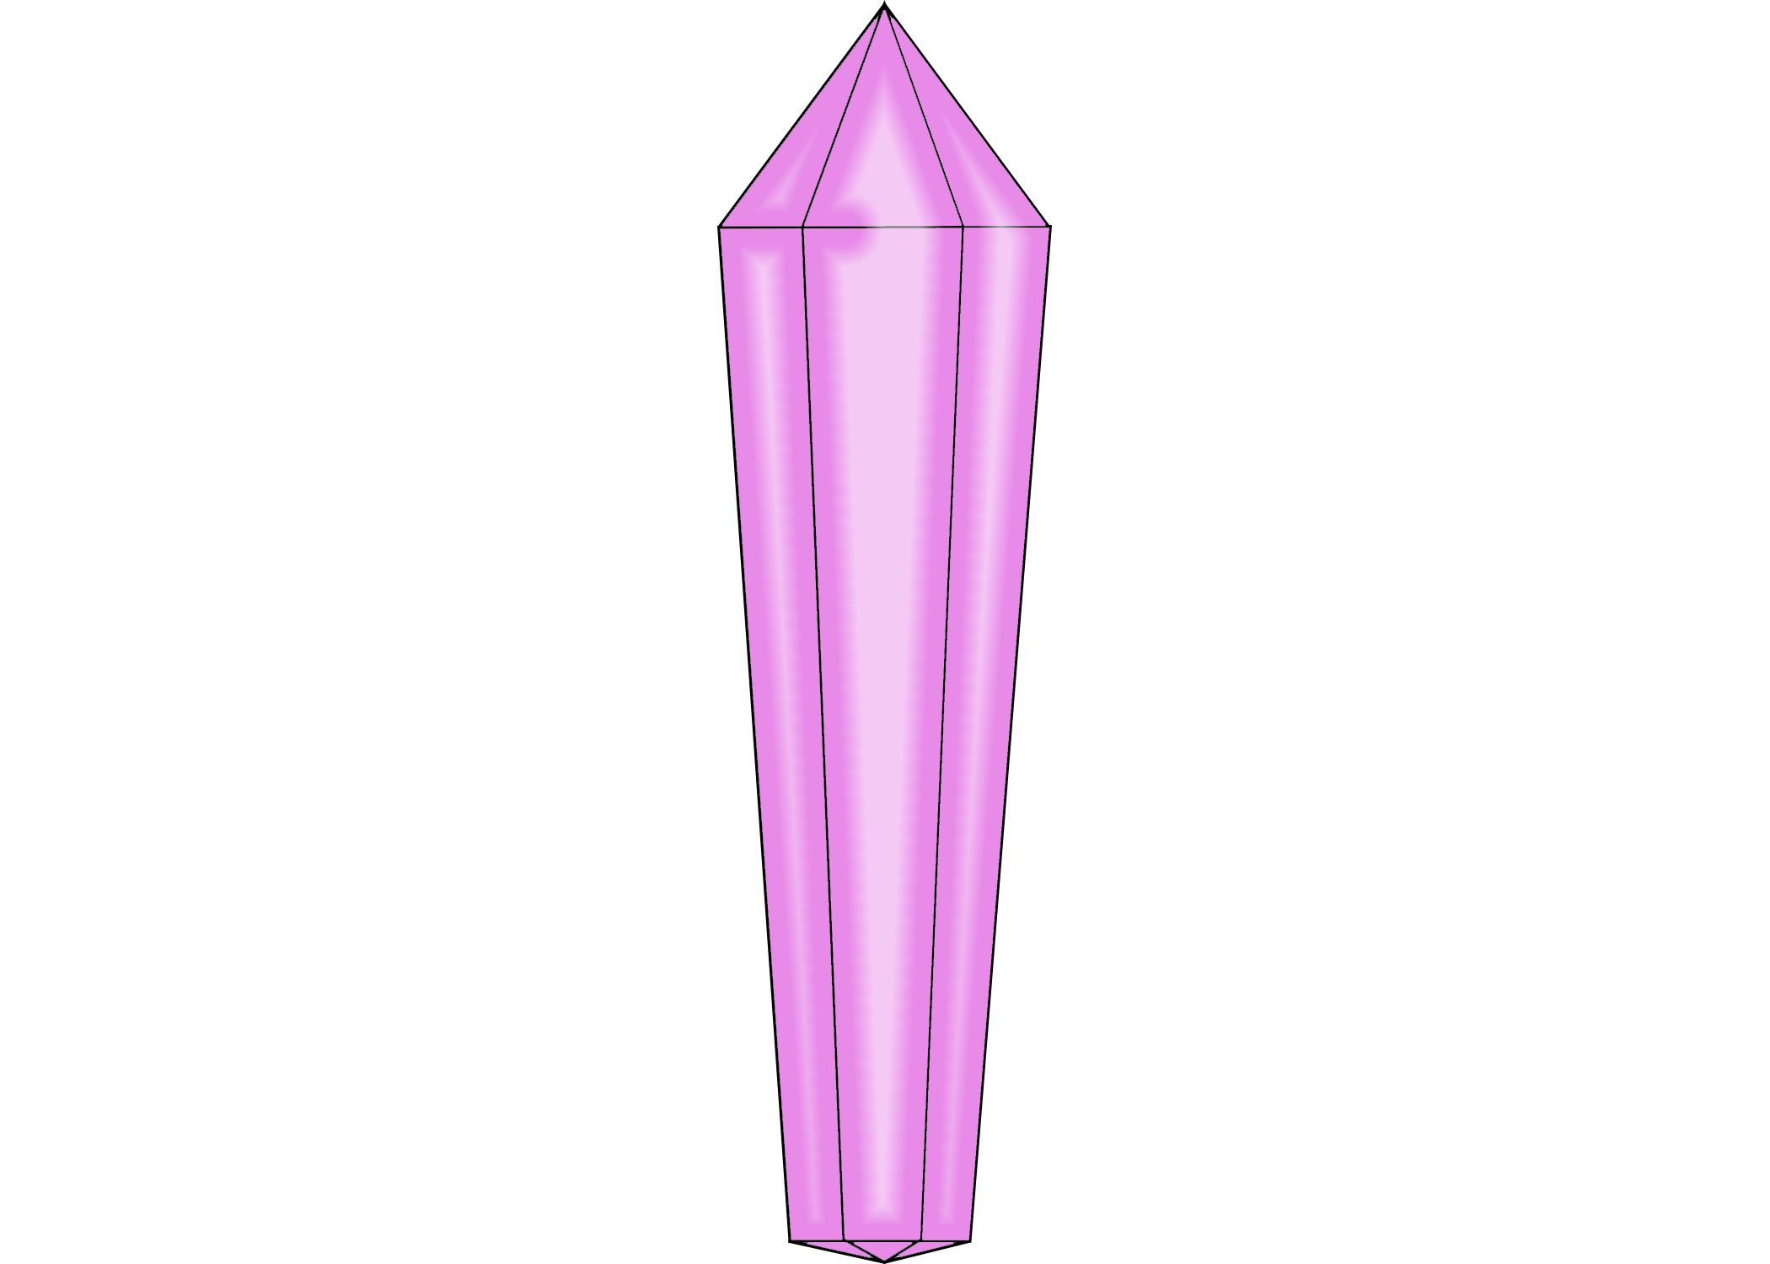
What We Learned
The importance of communication & delegation - Gabe
Importance of and experience with planning tasks thoroughly - Tre
Unreal Engine - Austin
Be more flexible with my skills - Evan
Rolling with the punches - Phyzon
Communication is important - Jordan
Unreal Engine - Drew
[INSERT KNOWLEDGE HERE] - Jayme

Slide 12
Questions For OUR FUTUREs?
Notes:
Because our future is bright.

